Slide 1
Homoeopathic Strategies in Hypertension
Session 2

Slide 2
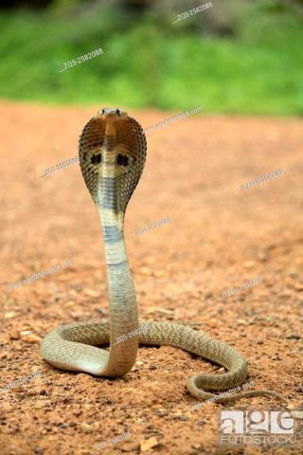
Naja tripudians
Cobra di Capello. The hooded snake of Hindustan.
N. O. Elapidae.
Tincture of the fresh virus.
Trituration of sugar of milk saturated with fresh virus.

Slide 3
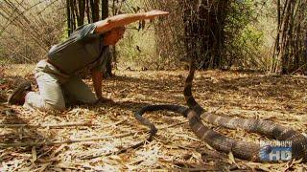

Slide 4
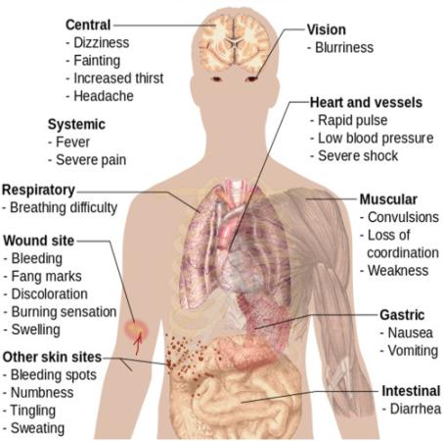
venom
All species in the genus Naja are capable of delivering a fatal bite to a human. Most species have strongly neurotoxic venom, which attacks the nervous system, causing paralysis, but many also have cytotoxic features which cause swelling and necrosis, and have a significant anticoagulant effect. Some also have cardiotoxic components to their venom.

Slide 5
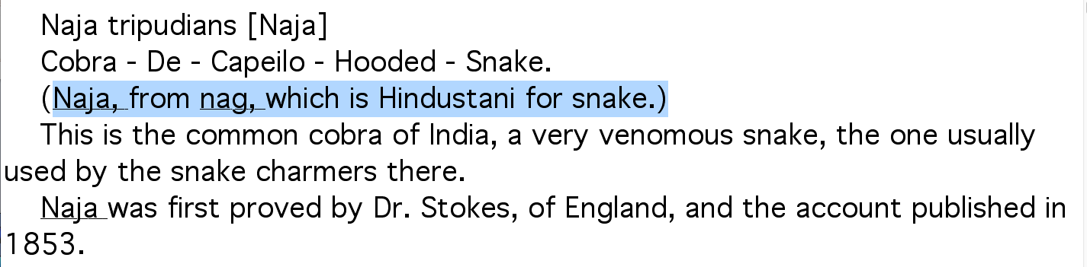

Slide 6
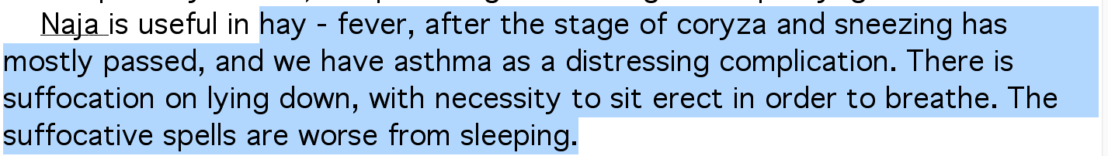

Slide 7
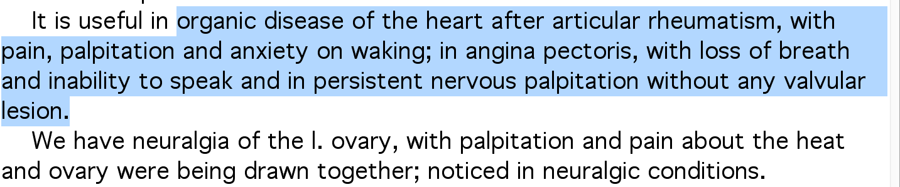

Slide 8


Slide 9



Slide 10


Slide 11


Slide 12


Slide 14
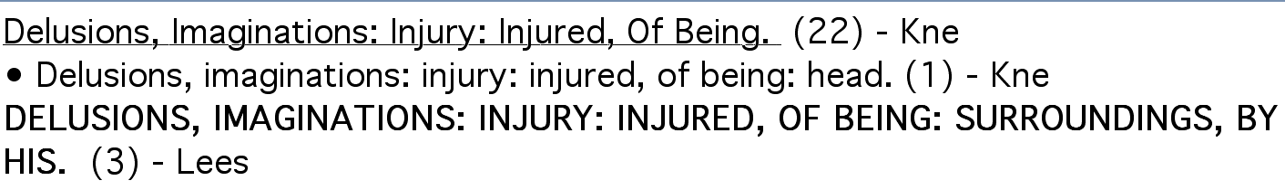


Slide 15
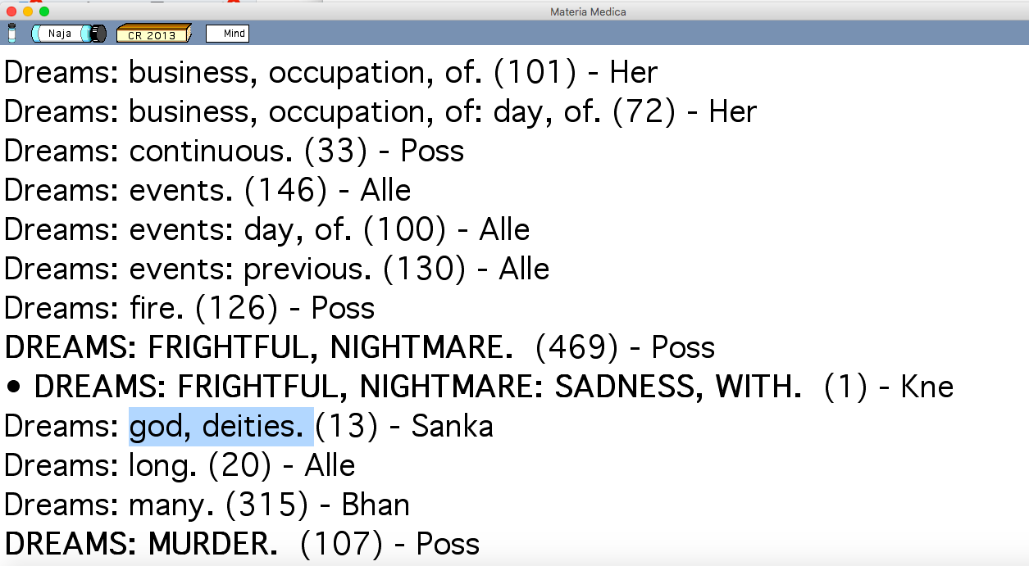

Slide 16
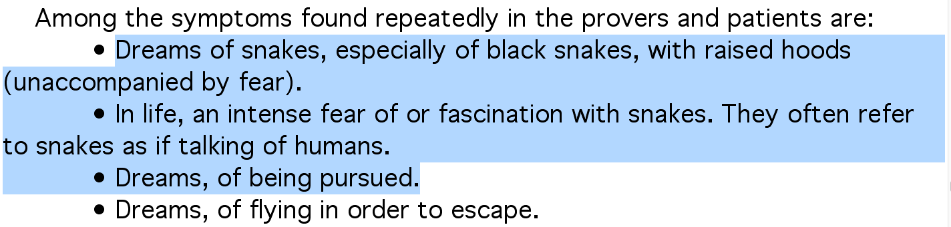
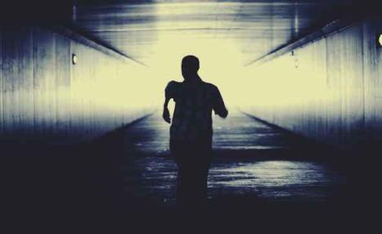


Slide 17



Slide 18


Slide 19



Slide 20
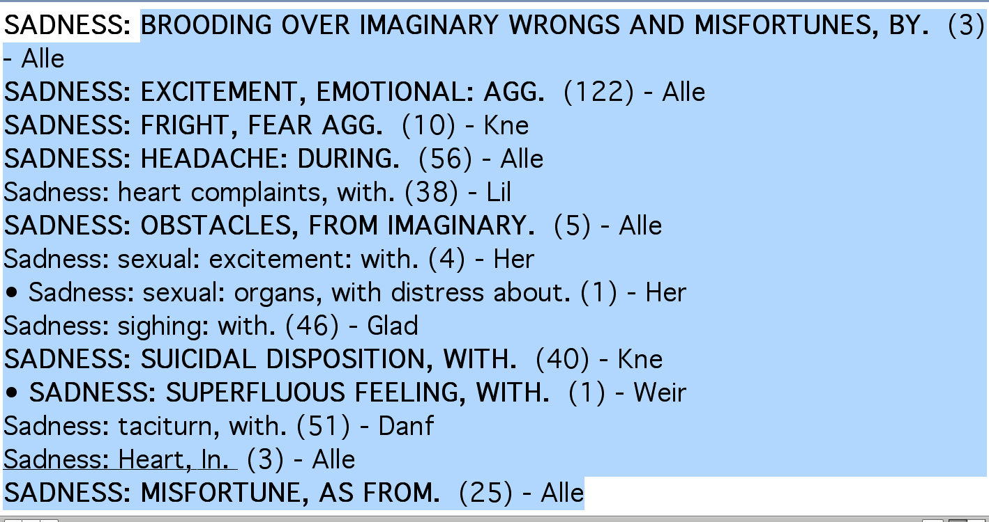

Slide 21


Slide 22
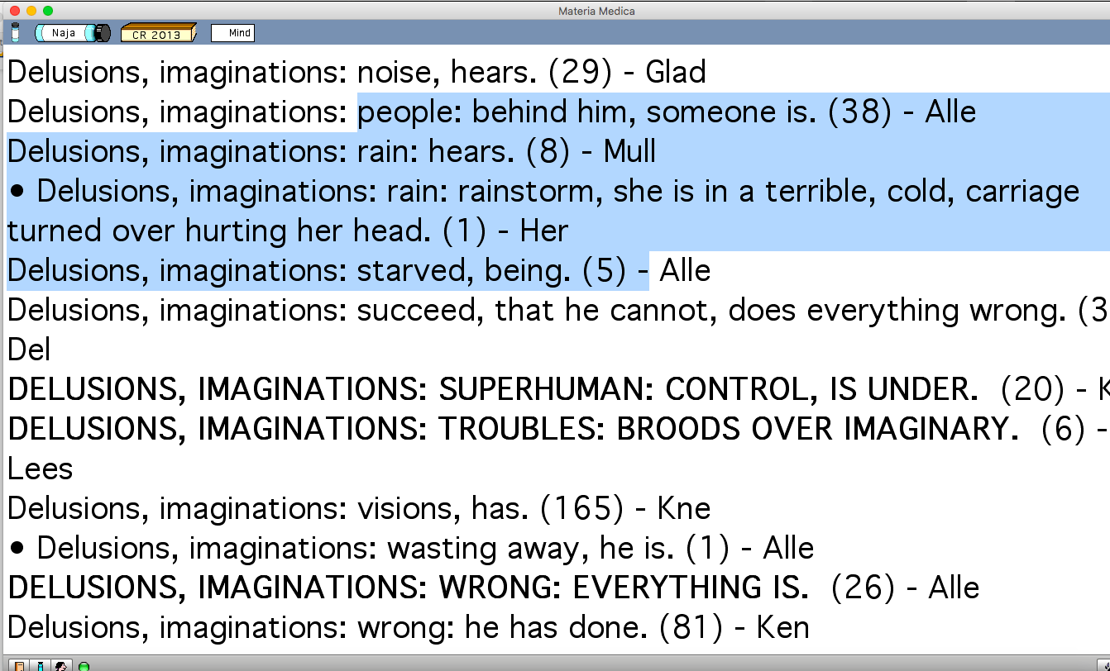

Slide 23
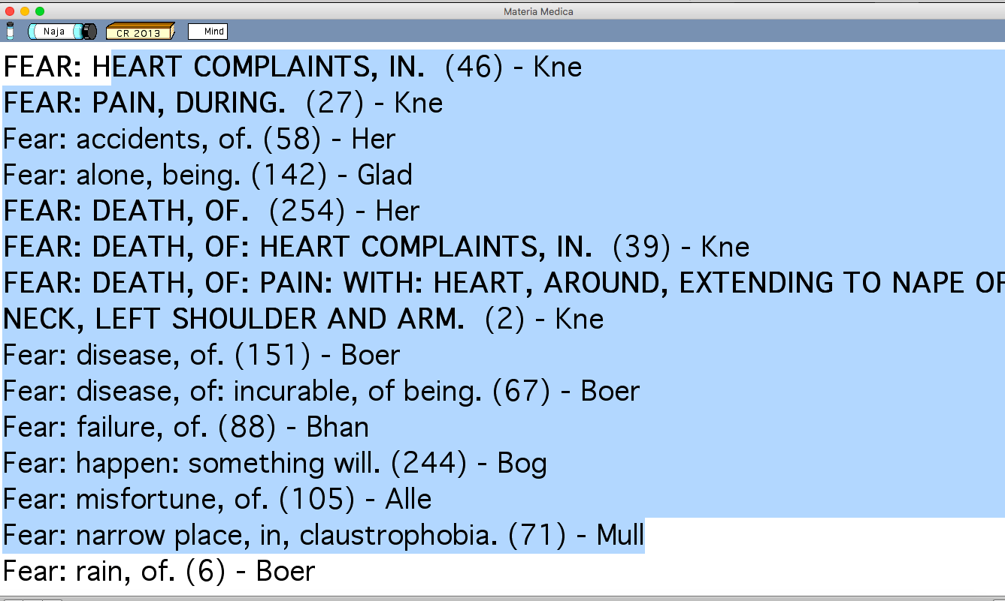

Slide 24
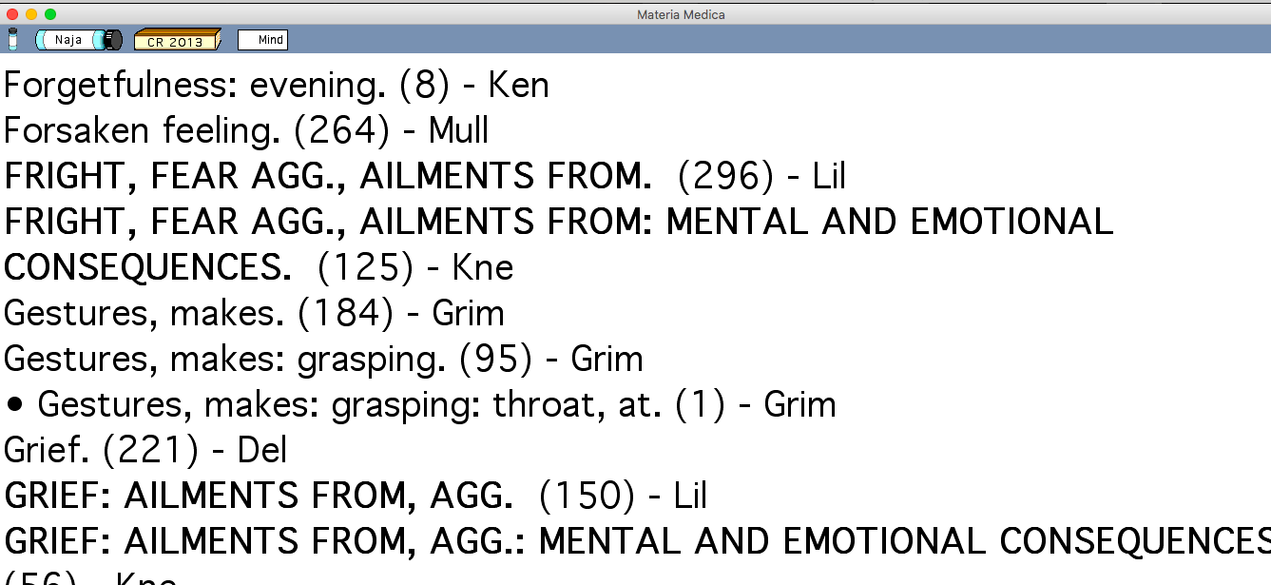

Slide 25
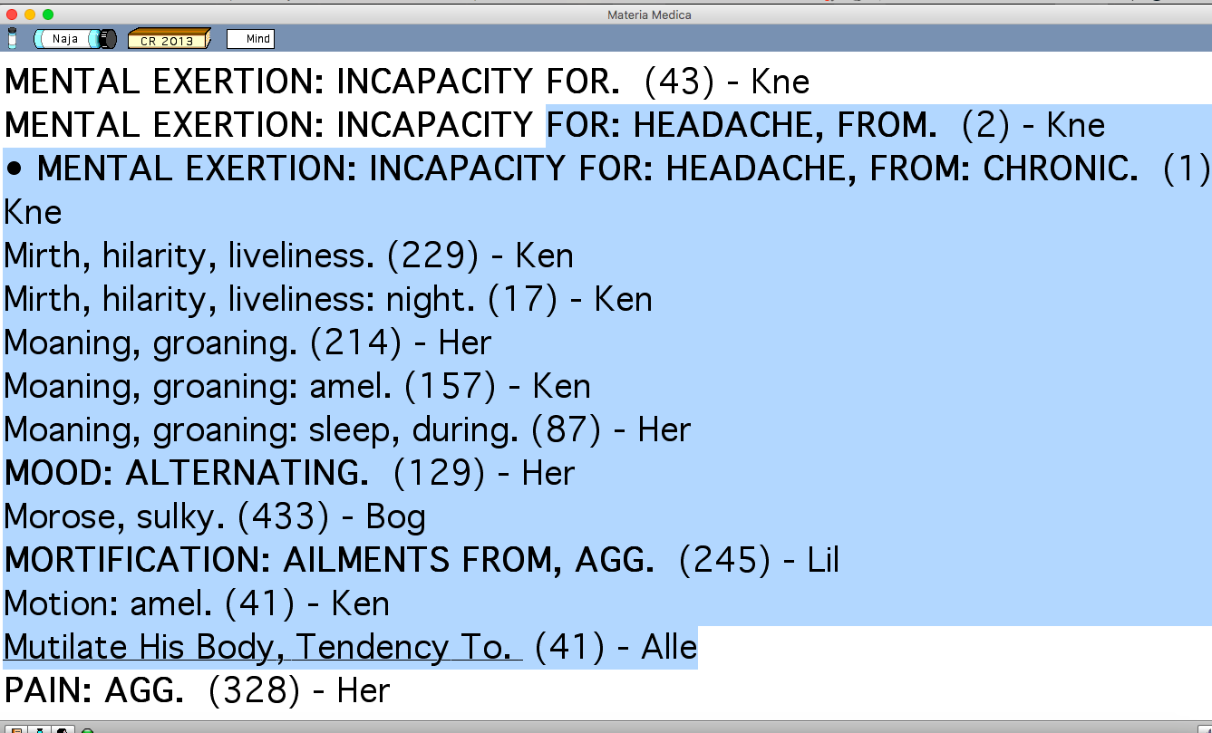

Slide 27



Slide 28

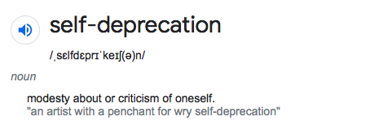

Slide 29
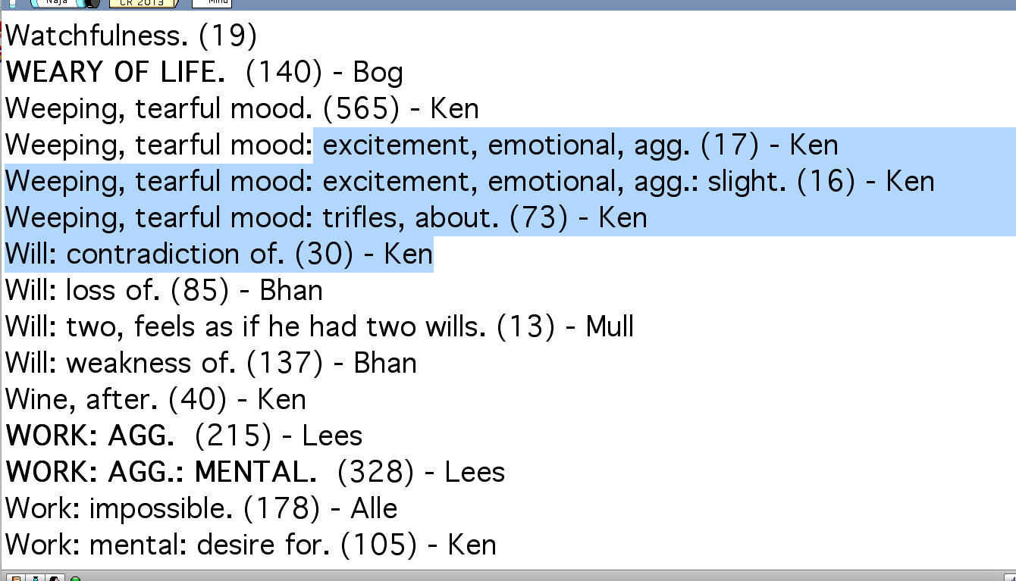

Slide 30
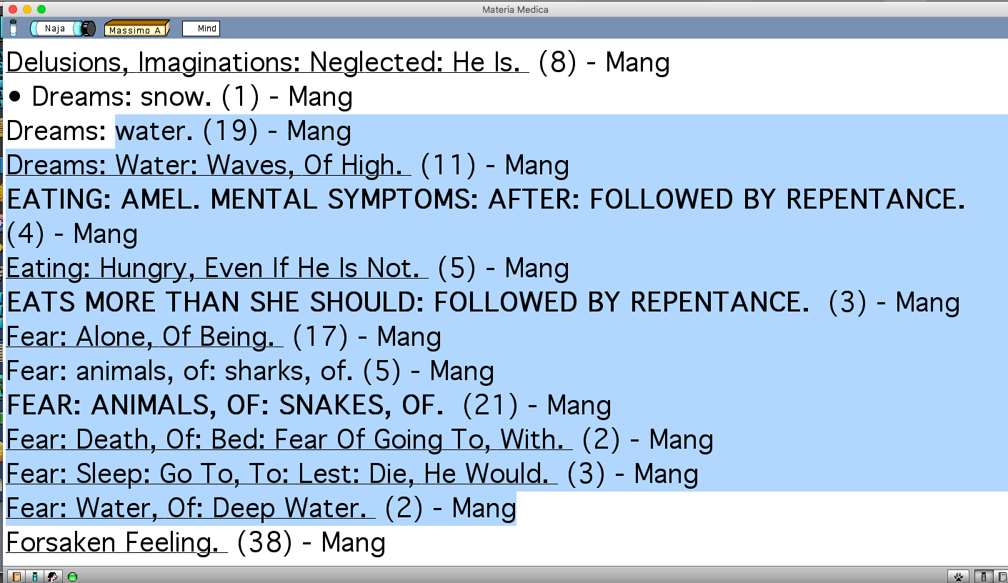

Slide 31
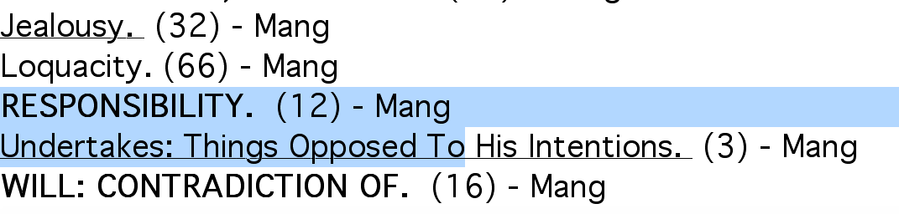

Slide 32
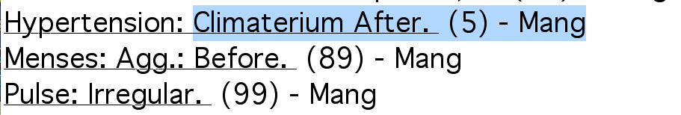

Slide 33
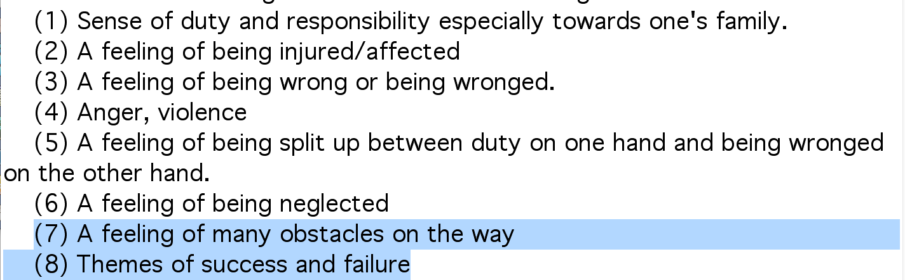


Slide 34
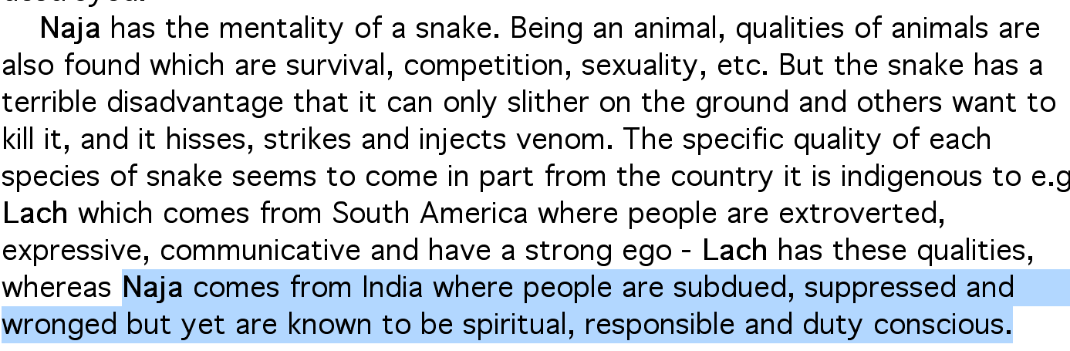

Slide 35
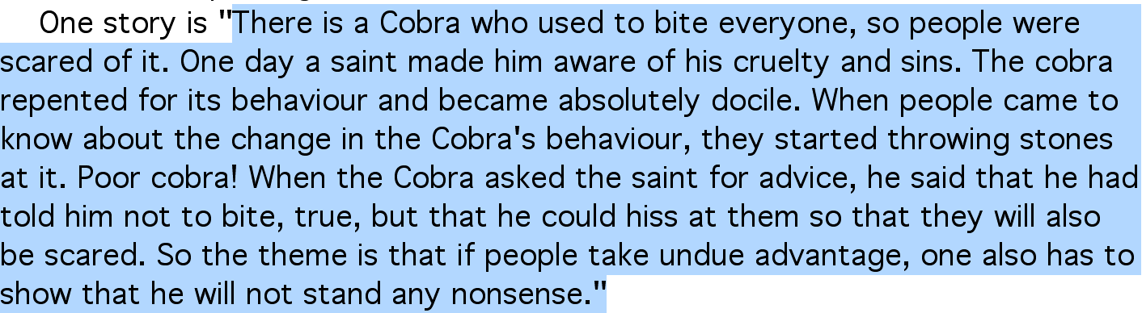

Slide 36
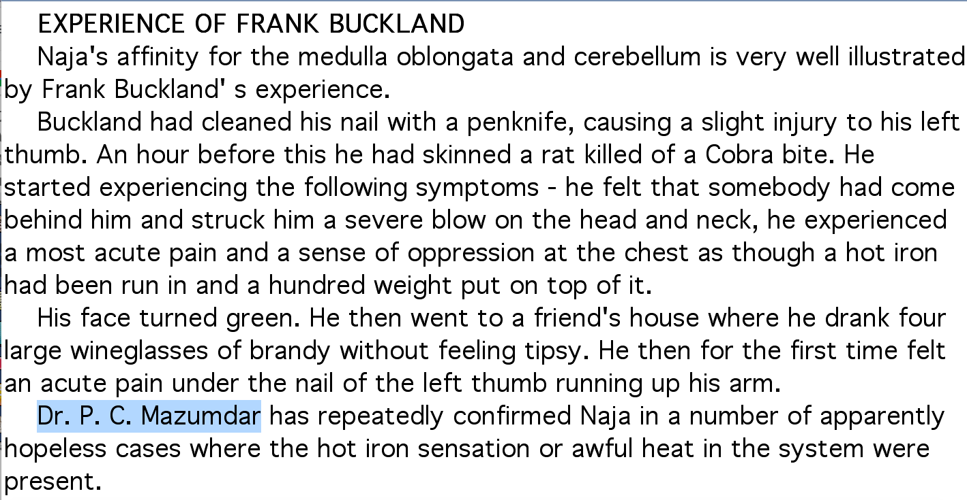

Slide 38
A theme of re-incarnation is strongly associated with the cobra in Indian mythology.

Slide 39

Physiologically chilly. Definite desire for warmth

Slide 40
Main themes of the remedy Naja includes:
(1) Sense of duty and responsibility especially towards one's family.
(2) A feeling of being injured/affected (physically or emotionally)
(3) A feeling of being wrong or being wronged.
(4) Anger, violence
(5) A feeling of being split up between duty on one hand and being wronged on the other hand.
(6) A feeling of being neglected
(7) A feeling of many obstacles on the way
(8) Themes of success and failure

Slide 41
HEART:
weakness at violent pain, shooting to left scapula. shoulder or neck cramp ascends into neck, holds hand over it, excited, tremendous action, palpitation, visible, hypertrophy, endocarditis, septic.
It’s a near specific for any kind of cardiac pathology when the valvular symptoms are not there

Slide 42
Phatak:
· Puffing breathing. Cardiac asthma; or cough. Dry or empty feeling in left lung. Ribs feel broken. Oppressive weight on chest; as if a hot iron had been run in.
Good remedy for asthma, when coryza followed by asthma, which is worse lying and better sitting up:
· Asthma preceded by coryza worse lying; better sitting up.
Another peculiar symptom is lot of sweating in hands and feet.
· Cramps in shoulders, nape or thighs. Numb left arm. Violent racking in marrow of thighs. Puffy or sweating hands and feet; with cough. Acute pain under the left thumb nail running up the arm. Loss of power.

Slide 44
Hypertension
Renal concomitant
Spartium scoparium - flatulence
Eels serum - no oedema
Naja - < lying on left side, reptile qualities
Digitalis - low pulse, H/O grief and prostration
Gastric concomitant
Spartium scoparium (renal + gastric)
Allium-s - increased meat desire
Gratiola - female nux
Congestive
Belladonna
Glonoine
Nat-m
Sang-c
Usnea
Amyl nit
Food associated
Acid reflux - robinia
Alcohol - strophanthus
Alcoholics - quercus glg
Cardiac
Lycopus - audible pulsation
Strontium carb - chilly, > warmth
Amyl nitrosum - flushes of heat
Stress
Rauwolfia - mental state increases
Naja - reptile theme
Aurum - high responsibility
Coffea high excitability
Calcarea ars - < slightest emotion
Rheumatic
Viscum alb - heat, unable to rest
Guiaicum - arthritis > rest
www.drgauranggaikwad.com

Slide 45
Group study
Kingdom study
Family study

Slide 46
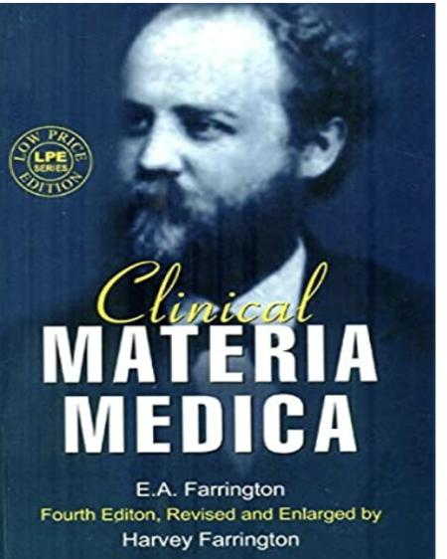

Slide 47
Some plant remedies
Plant families

Slide 48
Liliflorae

Slide 49
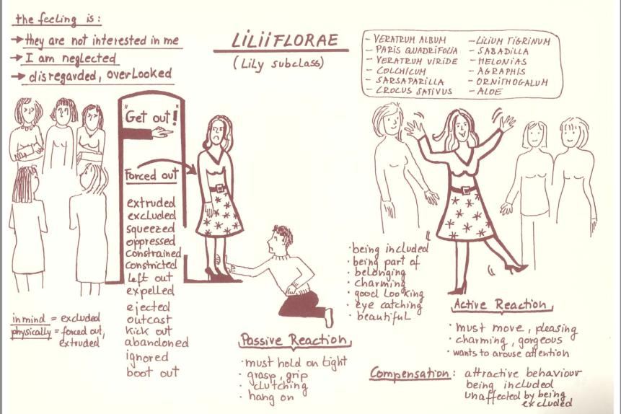

Slide 50
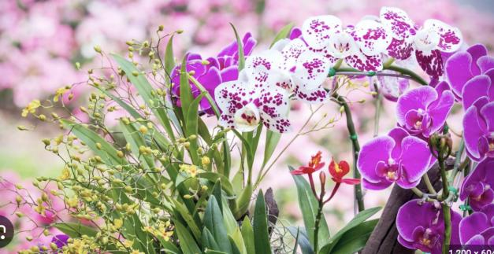
Orchids

Slide 51
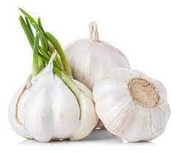
Allium sativum
Garlic — Liliaceae

Slide 52
Appearance and style is important for them
Many desires- hard to please
Tubercular miasm (likes to try new things)
Fleshy eaters (obese)
Prover- Petroz and Teste
Fear of medicine, hypochondriasis
Meat, alcohol, gourmands. Does not drink enough water
Preserves, purity of food.
Allium sativa and other allium have strong odor which keep others at arm distance.
At source level- they are used for flavour
bulimia-> capriciousness

Slide 53
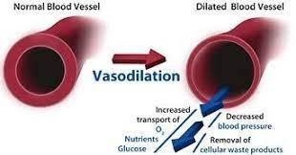
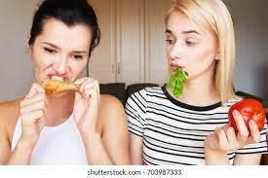
Allium-s
This medicine has vaso-dilatory properties.
Arterial hypotension begins 30-45 minutes after twenty to forty drop doses of the tincture.
The patient will present with the concomitant of desiring meat with no thirst.
There is heavy pulsation in the temples with catarrhal deafness.
Give this medicine to patients who eat a great deal of meat, more than they drink.
It acts better in meat eaters than strictly vegetarians.

Slide 54
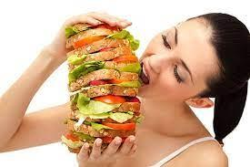
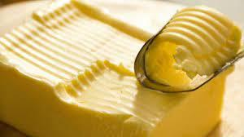
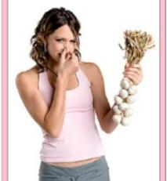
Noteworthy Symptoms:
- Voracious appetite
- High livers
- Desire for butter
- Complaints from bad water
- Slightest error in diet disturbs the stomach
- Much sweetish saliva after meals and at night
- Flabby subjects with dyspepsia
- Fear of being poisoned, when alone, very sad
- Smallest amount of garlic is intolerable

Slide 55
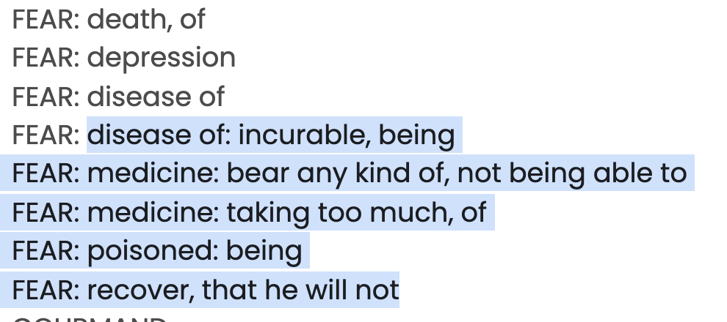
Many fears , Hypochondriasis ( similar to sabadilla )

Slide 56
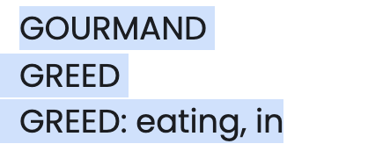

Slide 57
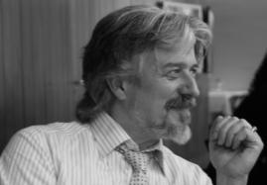
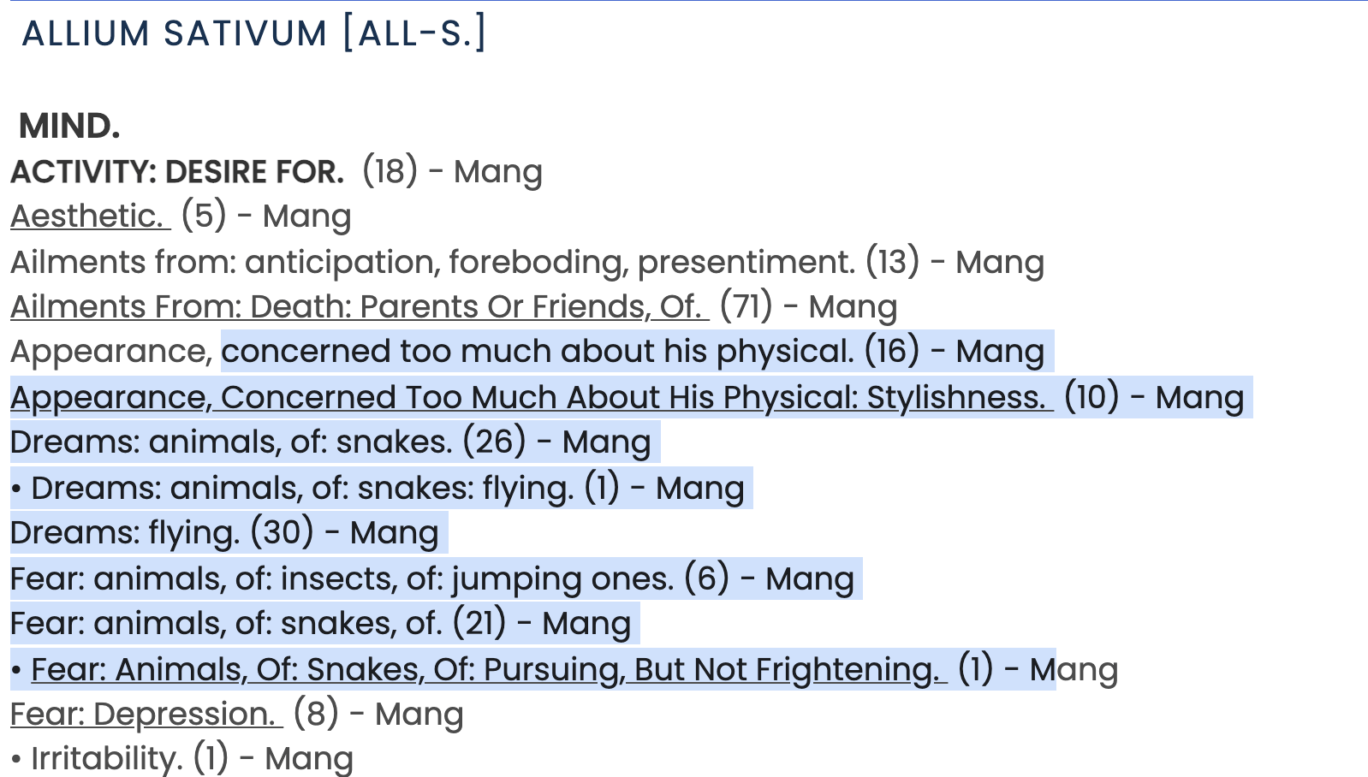

Slide 58
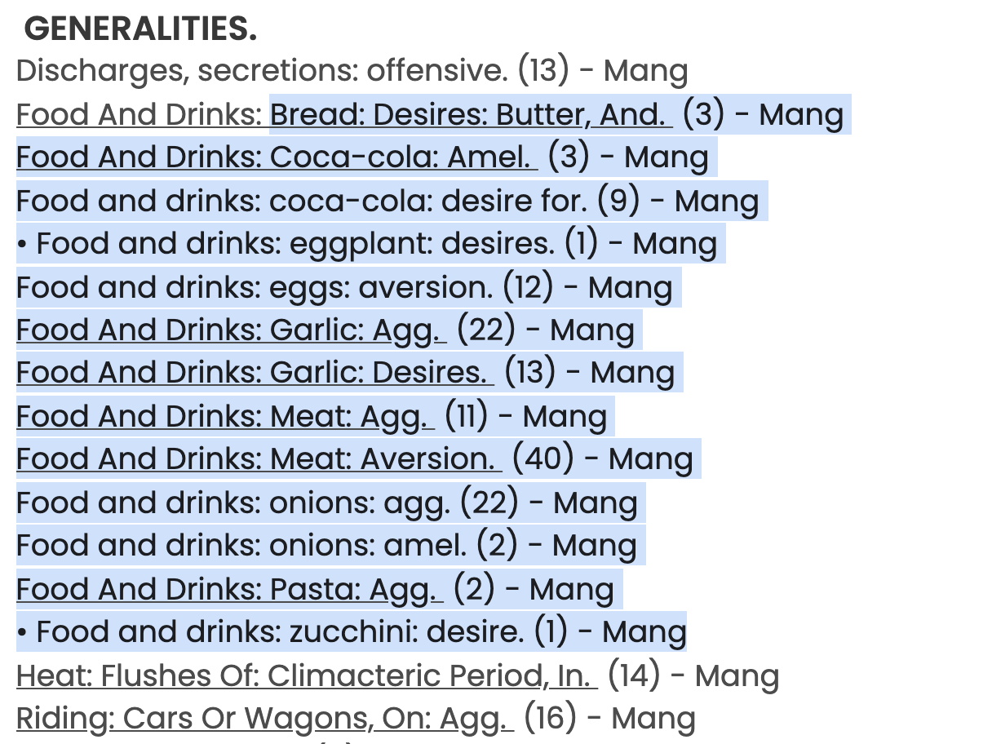

Slide 59
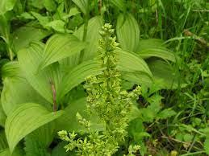
Veratrum viride
Green Hellebore. - - Melanthaceae.

Slide 60
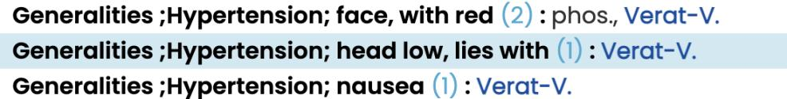
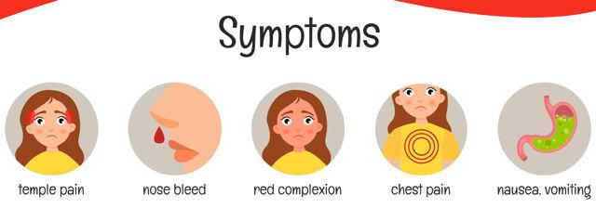

Slide 62
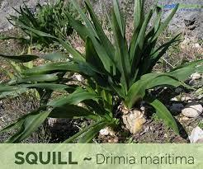
Squilla maritima
Sea Onion. (Red variety.) N. O. Liliaceae.

Slide 63
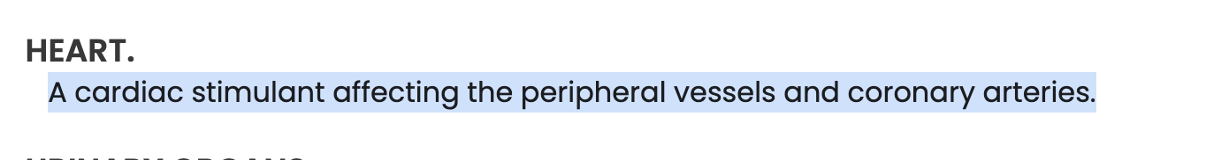

Slide 65
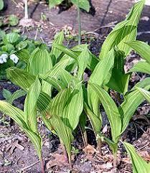
Convallaria majilis
Lily of the Valley. N. O. Liliaceae.

Slide 66
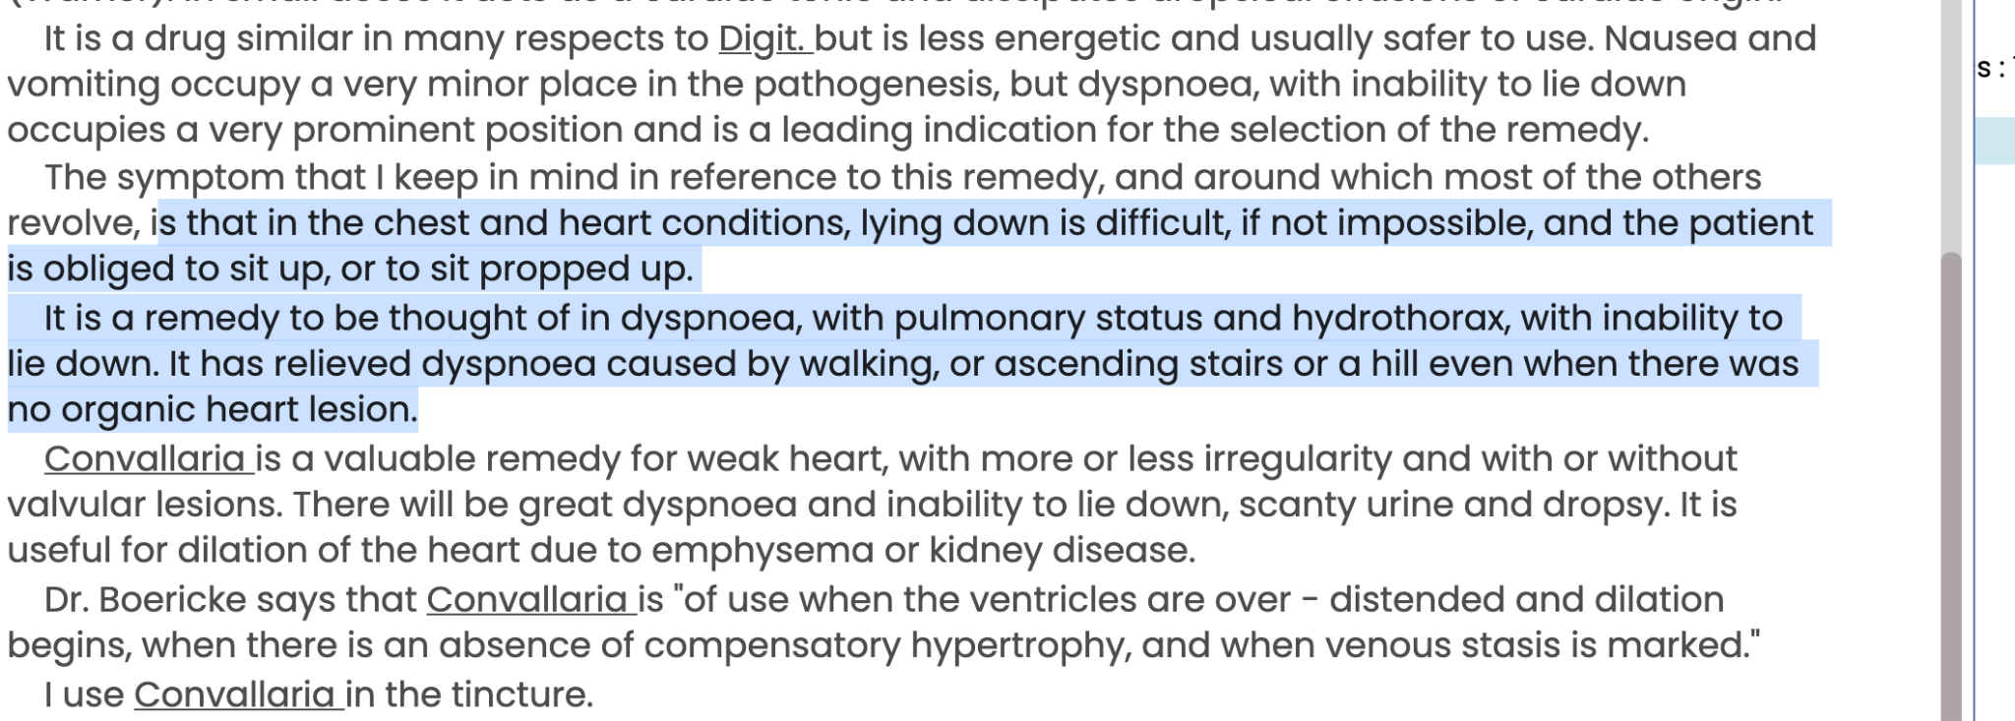
Pierce Plain talks

Slide 67
Convallaria majus is a beautiful remedy, Lilly family. Very hysterical and attention seeking. Especially I use it in young girls and young boys, or old men and women.
Typically, in certain cases with some heart problems the pumping of the heart is very low.
The LVF remains very low, sometimes 20, sometimes 25. It is the only remedy in homeopathy that can increase the energy of the heart action, it can improve the LVF.
I often use it in 6c potency.

Slide 68
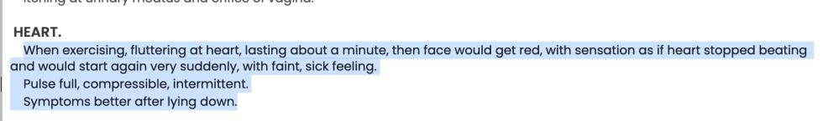

Slide 70
Allium sativum
Garlic — Liliaceae

Slide 71
Appearance and style is important for them
Many desires- hard to please
Tubercular miasm (likes to try new things)
Fleshy eaters (obese)
Prover- Petroz and Teste
Fear of medicine, hypochondriasis
Meat, alcohol, gourmands. Does not drink enough water
Preserves, purity of food.
Allium sativa and other allium have strong odor which keep others at arm distance.
At source level- they are used for flavour
bulimia-> capriciousness

Slide 72
Allium-s
This medicine has vaso-dilatory properties.
Arterial hypotension begins 30-45 minutes after twenty to forty drop doses of the tincture.
The patient will present with the concomitant of desiring meat with no thirst.
There is heavy pulsation in the temples with catarrhal deafness.
Give this medicine to patients who eat a great deal of meat, more than they drink.
It acts better in meat eaters than strictly vegetarians.

Slide 73
Noteworthy Symptoms:
- Voracious appetite
- High livers
- Desire for butter
- Complaints from bad water
- Slightest error in diet disturbs the stomach
- Much sweetish saliva after meals and at night
- Flabby subjects with dyspepsia
- Fear of being poisoned, when alone, very sad
- Smallest amount of garlic is intolerable

Slide 74
Many fears , Hypochondriasis ( similar to sabadilla )

Slide 78
Rosacae

Slide 79
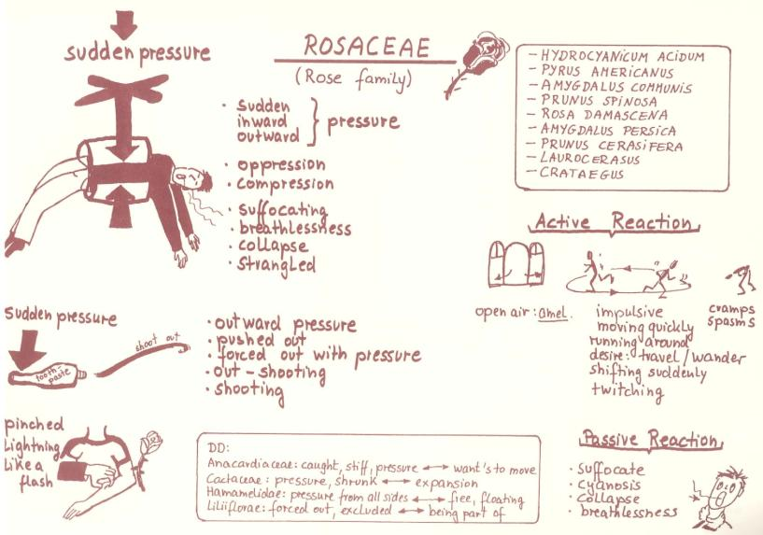

Slide 80
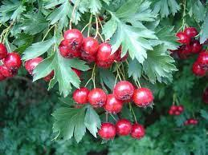
Crataegus
Hawthorn berries— Rosaecea

Slide 81

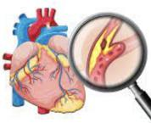
Ailment from
Trauma, cares/worry , sympathy
(cocc, caust)
Chilly
Sweat
concomitants
Diabetes (young age)
Heart calcareous deposits (IHD and blocks)
Crataegus
Dyspnea
Insomnia
Tissue remedy, absorbs scars
Hypertension- Increased diastolic, low systolic (opp baryta mur)

Slide 82
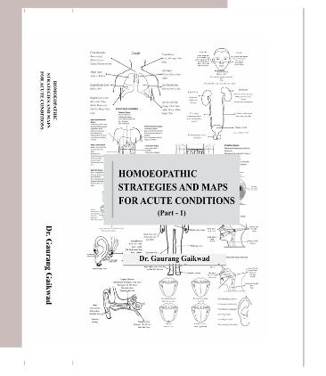
Homeopathic strategies and MAPS in ACUTE
gauranghg@gmail.com

Slide 83


Slide 84


Slide 85

Crategus oxycantha mother tincture,especially when the heart is affected and there is high blood pressure.
High blood pressure with giddiness
Heart complaints in old people with lots of block and stand
History of sleeplessness
Chilliness
Chronic heart complaint, in acute think of convollaria ( carb-veg, in cold extremities, collapse like state)
Gastric symptoms
Dropsy, fatty degeneration, chilliness and heart symptoms
Diabetes in children
Anxious, dullness, cervical spondylitis
Better : fresh air, quiet and rest
Aggravation : warm room
Relationship: Strophanthus, digitalis, Iberis, Naja, cactus

Slide 87

CLINICAL EXPERIENCES PHATAK
PRUNUS SPINOSA
Prunus spinosa
Black thorn.
Sloe.
N. O. Rosaceae.

Slide 88


Slide 89


Slide 90


Slide 91
HCN
Prussic Acid. Hydrocyanic acid

Slide 92
Complementary to Lauroceresus, lot of coldness
● Convulsions and paralysis, suffocation
● Collapse condition due to pulmonary pathology
● Fear of crossing road
● Supra orbital neuralgia with flushing on the same side of face
● Jaw clenched, froth
● Tongue cold
● Hydrocyanic acid is indicated in lung pathology, Lauroceresus is indicated in cardiac pathology
● Asthma with contraction of throat
● Irresistible drowsiness
● Relationship: Antidotes : Ammon; Camph, Lauroc

Slide 93


Slide 94

Laurocerasus
Cherry-laurel
Rosacea

Slide 95
Case of congenital cardiac disease with lots of cough in child, asphexia
● Spasmodic tickling cough especially in cardiac cases especially in children
● Noises when they eat or drink
● Body becomes cold, better by warmth
● Main sensation of this family is Suffocation
● Cyanosis, children puts hands on heart, dry cough, gasping, clutches the heart
● Clubbing of finger
● Deep sleep, stertorous breathing
● Coldness but not better by heat
● Compare: Hydrocy. Ac, camphor, secale, ammon. Carb, Ambra

Slide 96

CEANOTHUS AMERICANUS
Red-root. N. O. Rhamnacae

Slide 97



Slide 98

Agrimonia eupatoria
Liverwort
Belongs to the Rosaceae

Slide 99
These are people who have masked troubles, are anxious and worried internally, but have forced cheerfulness externally. They hide their sufferings, even though they are suffering an internal torment. So, agrimonia is comparative to remedies like Ignatia.
It is a very effective remedy in cases of cancers, especially stomach carcinoma and liver carcinoma.
Favourite remedy of dr sarkar

Slide 100
gauranghg@gmail.com
Clinical experiences -
PRUNUS SP
—
FARRINGTON MM

Slide 101
New Delhi - 30th JULY 2023 - workshop
—---

