Slide 1
Integrated Homeopathic approach in Hypertension
Homoeopathic Strategies in Endocrine and Lifestyle disorders
Session 1

Slide 2
What is hypertension ?
Blood pressure is determined both by the amount of blood your heart pumps and the amount of resistance to blood flow in your arteries. The more blood your heart pumps and the narrower your arteries, the higher your blood pressure. A blood pressure reading is given in millimeters of mercury (mm Hg). It has two numbers.
Top number (systolic pressure). The first, or upper, number measures the pressure in your arteries when your heart beats.
Bottom number (diastolic pressure). The second, or lower, number measures the pressure in your arteries between beats.

Slide 3
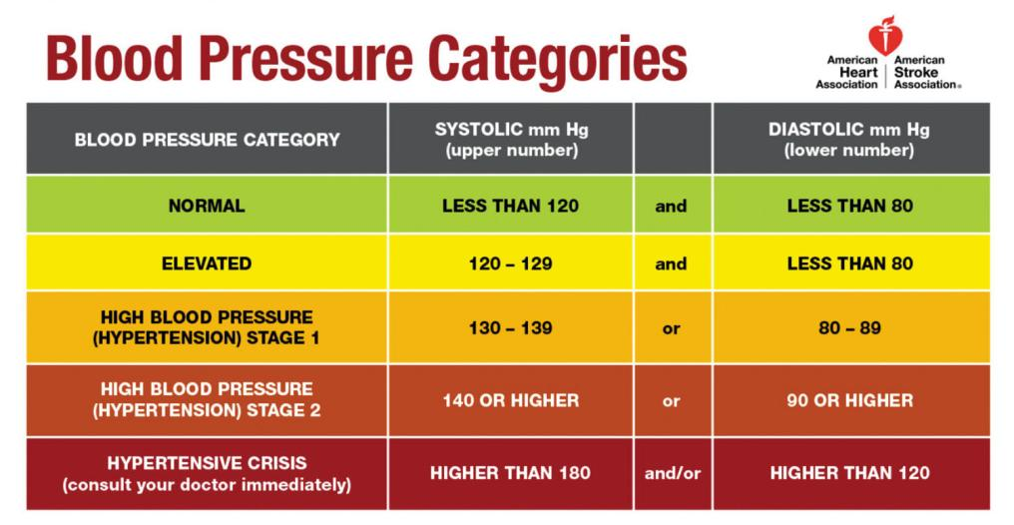

Slide 4
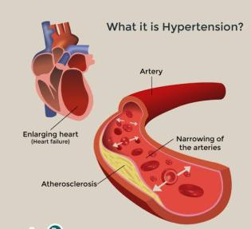
Symptoms
Most people with high blood pressure have no signs or symptoms, even if blood pressure readings reach dangerously high levels.
A few people with high blood pressure may have headaches, shortness of breath or nosebleeds, but these signs and symptoms aren't specific and usually don't occur until high blood pressure has reached a severe or life-threatening stage.

Slide 5
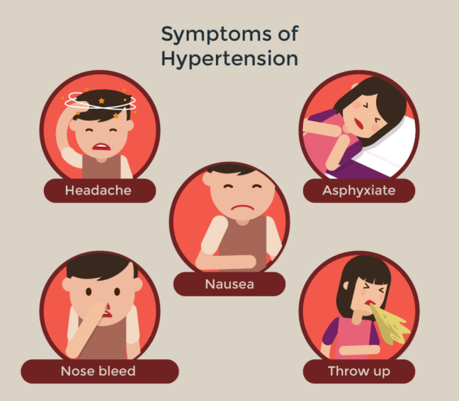

Slide 6
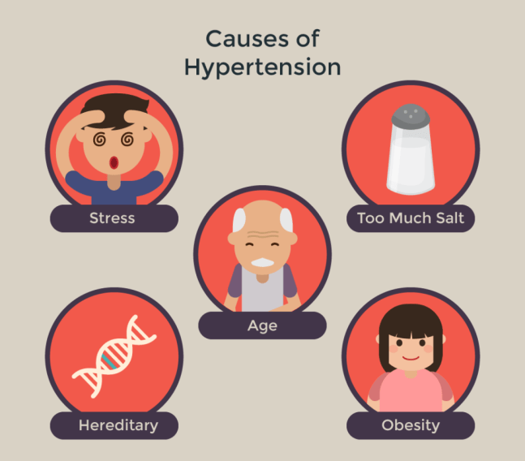
Causes
Alcohol
Obesity
Pregnancy (pre-eclampsia)
Renal diseases - renal vascular disease, polycystic kidney disease
Endocrine disease
Drugs

Slide 7
Causes
There are two types of high blood pressure
Primary (essential) hypertension
For most adults, there's no identifiable cause of high blood pressure. This type of high blood pressure, called primary (essential) hypertension, tends to develop gradually over many years.
Secondary hypertension
Some people have high blood pressure caused by an underlying condition. This type of high blood pressure, called secondary hypertension, tends to appear suddenly and cause higher blood pressure than does primary hypertension. Various conditions and medications can lead to secondary hypertension, including:

Slide 8
You might be more at risk if you:
are overweight
eat too much salt and do not eat enough fruit and vegetables
do not do enough exercise
drink too much alcohol or coffee (or other caffeine-based drinks)
smoke
do not get much sleep or have disturbed sleep
are over 65
have a relative with high blood pressure
are of black African or black Caribbean descent
live in a deprived area

Slide 9
Complications
The excessive pressure on your artery walls caused by high blood pressure can damage your blood vessels as well as your organs. The higher your blood pressure and the longer it goes uncontrolled, the greater the damage.
Uncontrolled high blood pressure can lead to complications including:
Heart attack or stroke
Aneurysm
Heart failure
Dementia
Weakened and narrowed blood vessels in kidney and eyes

Slide 10
Obstructive sleep apnea
Kidney disease
Adrenal gland tumors
Thyroid problems
Certain defects you're born with (congenital) in blood vessels
Certain medications, such as birth control pills, cold remedies, decongestants, over-the-counter pain relievers and some prescription drugs
Illegal drugs, such as cocaine and amphetamines

Slide 11
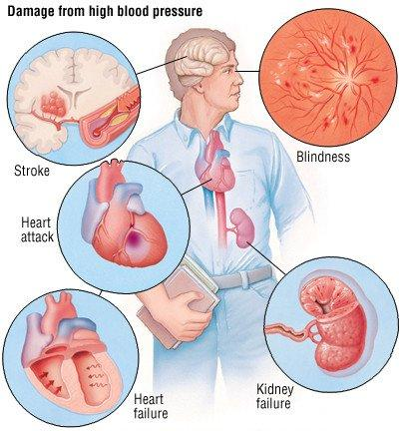

Slide 12
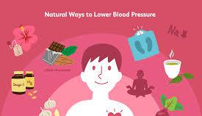
Homeopathy + lifestyles change = future of wellness

Slide 13
Lifestyle change
Nutrition ( what one eats / amount )
Exercise ( improving metabolism )
Positive state of mind ( way of thinking )
Avoiding mindset of victim

Slide 14
Primary (essential) hypertension– Remedies

Slide 15
Secondary hypertension remedies
Kidney disease- Spartium scoparium, eel serum, etc
Adrenal disease- Adrenalinum, etc
Hyperparathyroidism- Parathyroidinum, Thyroidinum etc
Thyroid problems- Lycopus virginia, Natrum muraticum, Spongia etc
Obstructive sleep apnea- Snake remedies, Carbons etc
Coarctation (constriction or tightening) of the aorta- Crategus, etc
Side effects from certain medications- Carbo veg, Nux Vom , RESERPINE etc

Slide 16
Complications of hypertension remedies
Heart attack or stroke
Aneurysm
Heart failure- Changes with memory or understanding
Dementia
Weakened and narrowed blood vessels in kidney
eyes - vision loss.
Obstructive sleep apnea
Kidney disease
Adrenal gland tumors
Thyroid problems
Metabolic syndrome.

Slide 17
Hypertension
Renal concomitant
Spartium scoparium - flatulence
Eels serum - no oedema
Naja - < lying on left side, reptile qualities
Digitalis - low pulse, H/O grief and prostration
Gastric concomitant
Spartium scoparium (renal + gastric)
Allium-s - increased meat desire
Gratiola - female nux
Congestive
Belladonna
Glonoine
Nat-m
Sang-c
Usnea
Amyl nit
Food associated
Acid reflux - robinia
Alcohol - strophanthus
Alcoholics - quercus glg
Cardiac
Lycopus - audible pulsation
Strontium carb - chilly, > warmth
Amyl nitrosum - flushes of heat
Stress
Rauwolfia - mental state increases
Naja - reptile theme
Aurum - high responsibility
Coffea high excitability
Calcarea ars - < slightest emotion
Rheumatic
Viscum alb - heat, unable to rest
Guiaicum - arthritis > rest
www.drgauranggaikwad.com

Slide 18
gauranghg@gmail.com
Write me questions , suggestions
—
al

Slide 19
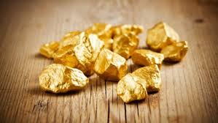
Aurum salts
Aurum Ars
Aurum Iod
Aurum Sulph
Aurum Mur
Aurum M Nat

Slide 20
Aurum salts

Slide 22
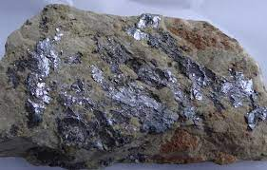
Aurum arsenicosum

Slide 23
Aurum Ars
Understanding of Arsenicum
﻿﻿The feeling is that now their defenses are weak; people are taking away things and they are too old to protect it.
﻿﻿Arsenic perceives thieves in the house itself constantly, who are robbing him more and more in comparison to Germanium (Column 14) where the situation is as though the robber came once and took things away, and one couldn't protect anything. Arsenic has to be and see how much extremely careful and cautious and see how much and how long he can preserve things.
• Things are going out of control (Cancer miasm). There is no one to go to; they have to do it themselves (the opposite of Kali and Calcarea and they can't do anything; the feeling is of being totally helpless.
Unlike Gallium where the feeling is that there is impending loss (of health, job, family, security, whatever he has built, etc, in Arsenicum the feeling is that the process of loss has begun and is continuing.
The question is, 'How much you can hold onto? It is slipping through your fingers and you are helpless in that situation.' They try to hold on to whatever they have because whatever has gone will not return to them.
Understanding of Aurum
﻿﻿He has reached the top position and has to maintain this position by handling responsibilities in every circumstance.
﻿﻿His ability is subjected to lot of attacks and challenges
The feeling is, "Are you good enough? Every crisis is a test of your ability to keep control, take charge, to maintain the position etc. Are you capable of running an organization?"
It is like a prime minister of a country who has already been chosen as a leader and reached the top position but now needs to maintain this position by constantly maintaining the standard of performance or else he will lose the confidence of others and himself.

Slide 24
Understanding of aurum ars
Insecurity, fear of losing security, fear of losing his or someone’s health and wealth, in a situation of great responsibility.

Slide 25
Chemically it is - Arsenate of Gold
Belongs to the Mineral kingdom
Used as a remedy in anaemia, cancer, chlorosis, lupus. Cancer based on a tubercular soil or on a syphilitic constitution (acquired or inherited). Blood, glands, and bones are the frequently involved sites of Action.
The depression of Aurum metallicum and the anxiety of Arsenic are often present in cases needing this remedy.
Mind, ANGER, irascibility, tendency: mistakes, over his.
Mind, CENSORIOUS, Critical

Slide 26
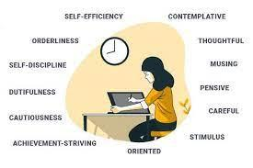
They often get dreams of falling.
Mind, DREAMS, falling
He is highly responsible and dictatorial (Aurum met), also fastidious and hurried (Arsenic). He is very caring about his wife who is ill. This care for his wife combines the ‘care about relatives’ of Arsenic and the ‘responsibility’ of Aurum. ‘Indifferent to domestic duties’ is an important symptom of Aurum-ars and it represents the failed side of the drug, i.e. feeling of tremendous sense of domestic duty. Even the physical signs of this man are divided between Aurum (knobby nose) and Arsenic (ribbed nails).
Mind, CONSCIENTIOUS, trifles, about
Mind, DUTY, great sense of

Slide 27
The main theme of Aurum-ars is that he feels responsible but also feels that he could be cheated by the person for whom he is responsible.
The Arsenic person takes too much care of others; this is a kind of guarantee against being let down by them. Thus it has both the feelings – ‘Mistrustful’ and ‘Cares for others’.
In Aurum-ars, the responsibility is accompanied by the care for others, because on one hand there is guilt (Delusion, neglected his duty) but also the mistrust and feeling that he will be let down (Arsenic). So the main components of Aurum-ars are care and responsibility.

Slide 28
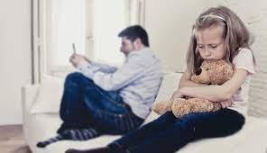
Censorious with everybody
Conscientious about trifles
Delusion, wrong he has done
Reproaches himself
Neglects her children (single symptom)
Indifference to domestic duties
They have disgust for life, with suicidal tendency. Anguish with increased attempts at self - destruction. They become violent on the least contradiction, quarrelsome, irritable, melancholy and longing for death. They imagine that they cannot succeed in anything, so they wish to be alone.

Slide 29
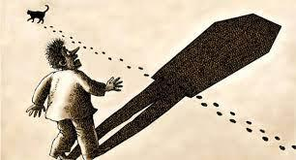
Weeping mood; thinks his friends have forsaken him. They become apprehensive on hearing a noise; they also have a fear of persons intruding. There may often be alternations of laughing and weeping. Religious melancholy.
Mind, INSANITY, madness, religious
Mind, INSANITY, madness, fanatics, of
Mind, PUNCTUALITY, always on time
Mind, REPROACHES others, insult, for imaginary
Mind, TACITURN, indisposed to talk, alternating with violence
Mind, SUPERSTITIOUS
Mind, AMBITION, much, ambitious

Slide 30
Some of its general symptoms are:
Over - sensitiveness to pain and cold.
Need fresh air.
General orgasm of blood, with violent palpitations.
Bruised pain in the head and limbs.
Paralytic, tearing pains in the joints, especially in the morning on waking, or if the parts become cold. Pain is aggravated by lying, ameliorated by rising.
It causes rapid increase of appetite. Increase of appetite. Aversion to food and meat. Desire for alcoholic stimulants. Desire cold drinks and milk.

Slide 31
Chronic aortitis, lupus, phthisis in syphilitic headaches; also in anaemia and chlorosis.
Head - Chronic syphilitic headaches.
LUNGS - Dyspnoea, desire for open air. Tuberculosis.
MODALITIES - Better heat, warm bed. Better summer. Worse open air. Worse cold, wet weather. Worse mental and physical exertion.

Slide 33
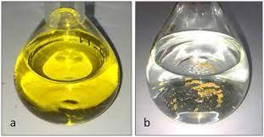
Aurum mur natronatum
(Double chloride of Gold and Sodium. Na Cl Au Cl3 2H20)

Slide 34
It has been commended in chronic irritation and even in chronic inflammation of the uterus and ovaries, where this condition has made a profound impression upon the nervous system, and induced nervous exhaustion with a general atonic condition of the system. It has been long used in syphilis and other blood dyscrasias with impaired nutrition, enlarged lymphatic glands and scrofulous swellings or ulcerations. In cases of diabetes mellitus, this remedy is of great importance.

Slide 35
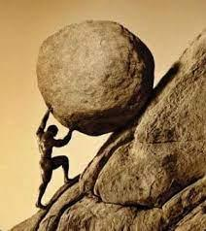
The main feeling of Aurum-mur-nat is the need to take up strong responsibility; they must perform tasks which are impossible or much beyond their capacity. Another side is the feeling of being let down or betrayed or disappointed by the person on whom their trust depends.
They almost form a cover upon their personality, almost nothing touches them. Because of their life situations and reactions, they become very tough people. They are very stoic people, they never show their emotions.
● Mind, REMORSE
● Mind, SELF-AWARE, little, too

Slide 36
Aurum-mur-nat comes very close to Carcinosin, especially with the need to do tasks which are beyond their capability, the need to keep things under control. Even the miasm and range of pathologies are similar. So, in many cases where we think of Carcinosin, we can alternatively think of Aurum-mur-nat. Aurum-mur-nat is also similar to Causticum, especially with the state of anxiety and lot of care for people around. However, Causticum will be anxious mainly for his group or family, but Aurum-mur-nat will be more in need to do tasks beyond his capacity.
● Mind, RESPONSIBILITY, ailments from, agg., unusual

Slide 37
They are particularly sensitive about what others will think about them, especially general public and society, hence, the fear of failure, and cautiousness develops within them, which also gives rise to the feeling of fragility and restriction within them. They also develop a desire to please others, so they want to be on time, almost to the extent of fear of failure and extreme anticipation.
● Mind, FEAR, opinion of others, of ● Mind, FEAR, failure, of, makes plans to avoid ● Mind, FEAR, happen, something will ● Mind, DELUSIONS, imaginations, fail, everything will

Slide 38
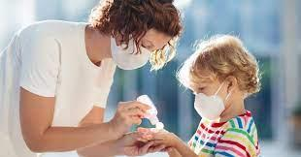
They remain very cautious, because of the fear that a mistake can lead to undesirable consequences. They become anxious and restless when given a deadline for anything. ● Mind, CAUTIOUS ● Mind, ANXIETY, time is set, when a They also fear that they might get an infectious disease. ● Mind, FEAR, disease, of, contagious, epidemic, infection, infecting others

Slide 39
They usually suffer from a strong feeling of guilt, of not doing their work, of not fulfilling their responsibility. They feel as if they have done something wrong.
● Mind, DELUSIONS, imaginations, insulted, he or she is ● Mind, DELUSIONS, imaginations, neglected, duty, his ● Mind, DELUSIONS, imaginations, wrong, he has done A clinical situation one finds with Aurum-mur-nat is that of being very attached to a mother-like figure in the family. Later on, they may also develop an aversion towards their family members. Dr. Sarkar sir once told me the formula: Smiling grief + Hardened people, in cases where there is deep pathology, think of Aurum-mur-nat.

Slide 40
They have a forsaken feeling in their mind, a strong feature of Aurum. The other important theme, i.e. the feeling of being betrayed or cheated comes from the natrum and muriaticum elements.
● Mind, DELUSIONS, imaginations, deserted, forsaken ● Mind, DELUSIONS, imaginations, doomed, being ● Mind, DELUSIONS, imaginations, neglected, duty, his ● Mind, DELUSIONS, imaginations, useless ● Mind, DREAMS, betrayed, having been

Slide 41
The important clinical symptoms of Aurum-mur-nat are: ● Worst forms of psoriasis and warts can be easily cured by this remedy. ● Recurrent stye in the eye. ● Cracked nasal mucosa is a prominent feature of this remedy. ● In cases of nephritis, Aurum-mur-nat can be thought of. ● Glandular and bone tumors, or in cases where there is metastasis to the brain, think of this remedy. ● good remedy for high blood pressure.

Slide 42
The general indications of Aurum-mur-nat are as follows: ● Generalities, FOOD and drinks, chocolate, desires ● Generalities, FOOD and drinks, meat, desires ● Generalities, FOOD and drinks, salt or salty food, desires ● Generalities, FOOD and drinks, stimulants, desires ● Generalities, FOOD and drinks, sweets, desires ● One of the main sensations of this remedy is BORING PAINS. ● Cold or wet weather aggravates. ● White tongue. Dirty looking teeth that get loose. ● Dark urine. ● Sweat is copious, with yellow skin. ● Lean emaciated person with pressure over the eyes, the whites of which are yellow. ● Pale complexion. Fetid odor from the mouth. ● Constipation. Stools like white clay.

Slide 43
Indications of this remedy in carcinoma cases are : Carcinoma on a syphilitic base; marked boring pains; cancerous warts on tongue; affections of bones and glands; enormous induration of an ovary; Induration of one part, with softening of another part; corrosive leucorrhea; pustules on genitals; carcinoma of breast and uterus.

Slide 44
The general indications of Aurum-mur-nat are as follows: ● Generalities, FOOD and drinks, chocolate, desires ● Generalities, FOOD and drinks, meat, desires ● Generalities, FOOD and drinks, salt or salty food, desires ● Generalities, FOOD and drinks, stimulants, desires ● Generalities, FOOD and drinks, sweets, desires ● One of the main sensations of this remedy is BORING PAINS. ● Cold or wet weather aggravates. ● White tongue. Dirty looking teeth that get loose. ● Dark urine.

Slide 45
● Sweat is copious, with yellow skin. ● Lean emaciated person with pressure over the eyes, the whites of which are yellow. ● Pale complexion. ● Fetid odor from the mouth. ● Constipation. Stools like white clay.

Slide 46
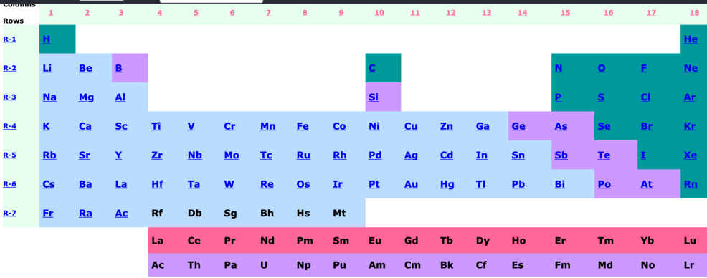

Slide 47
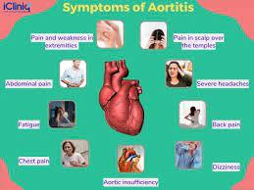
Aurum salts
Aur. ars: (chronic aortitis, lupus, phthisis in syphilitic headaches; also in anaemia and chlorosis. It causes rapid increase of appetite.)

Slide 48
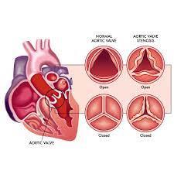
Aur. brom: (in headaches with neurasthenia, megrim, night terrors, valvular diseases.

Slide 49
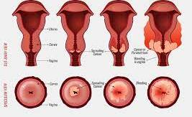
Aur. mur. Kali: Double chloride of Potassium and gold. (In uterine induration and haemorrhage.)

Slide 50
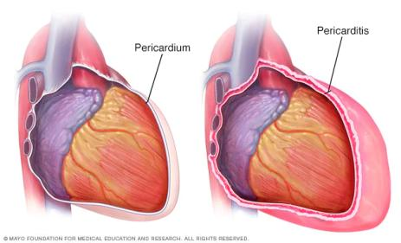
Aur. iod: (Chronic pericarditis, valvular diseases, arteriosclerosis, ozaena, lupus, osteitis, ovarian cysts, myomata uteri, are pathological lesions, that offer favorable ground for the action of this powerful drug. Senile paresis.)

Slide 51
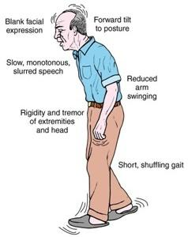
Aur. sulph: (Paralysis agitans; constant nodding of the head; affections of mammae; swelling pain, cracked nipples with lancinating pains.)

Slide 52
Aur. mur: (Burning, yellow, acrid leucorrhoea; heart symptoms, glandular affection; warts on tongue and genitals; sclerotic and exudative degeneration of the nervous system. Multiple sclerosis. Morvan's disease. Second trituration. Aur. mur. is a sycotic remedy, causing suppressed discharges to reappear. Valuable in climacteric haemorrhages from the womb Diseases of frontal sinus. Stitching pain in left side of forehead. Weariness, aversion to all work. Drawing feeling in stomach. Cancer, tongue as hard as leather; induration after glossitis.)

Slide 53
Aurum Salts
Aurum iod
Hypertension
Heart condition
Uterine pathology
Aururm ars
Aurum+ars (symptoms)
Cardiac symptoms
Lupus
Cancer
Anxious
Tubercular miasm
Conscientious
suspicious
Aurum mur nat
Aurum+ nat m
Autoimmune conditions
Prostate enlargement
Uterine tumors
Cancers
Aurum sulph
Parkinsonism
Titubations
egoistic
Aurum mur
Sycotic
Tongue coated
paralysis

Slide 54
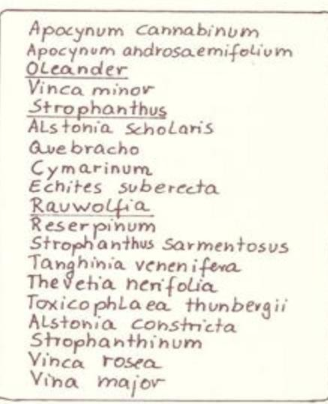

Slide 55
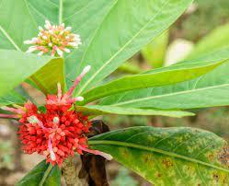
Rauwolfia serpentina
Apocynaceae

Slide 56
Rauwolfia serpentina. N. O. Apocynaceae family. Java and India. Containing, among others, the alkaloid reserpine. The tincture is prepared from the root. Historical dose: Tincture and all potencies.

Slide 57
STRESS RELATED hypertension – rauwolfia MT
This remedy is known as the Indian Aurum metallicum.
Sometimes you will see patients who have increased blood pressure and are depressed or irritable. However, this remedy does not have the syphilitic tendency like Aurum met.
This remedy can help to control blood pressure and is used in mania and madness (in Uttar Pradesh). Sleeplessness + increased blood pressure is the keynote of this remedy.

Slide 58
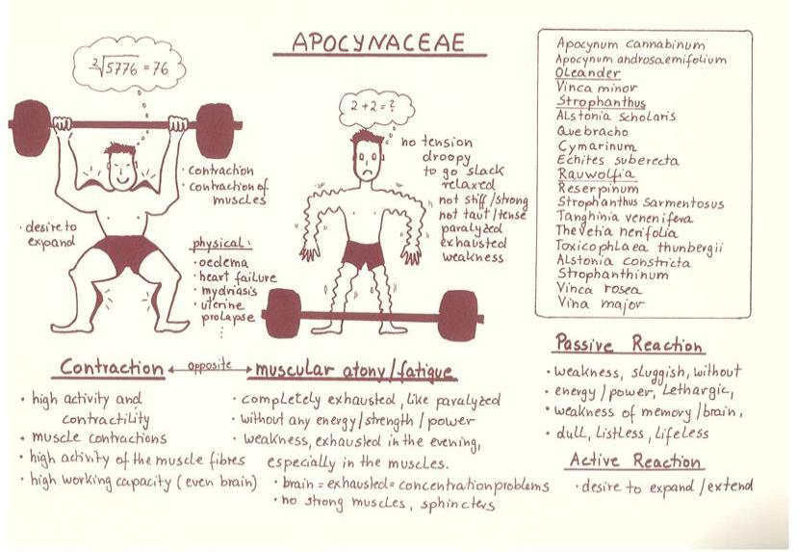

Slide 59
Other indications for this remedy include:
- Depression, suicidal tendency, loathing of life.
- Withdrawal effects of aspirin – depression.
- Palpitation, stool not clear - anxiety neurosis.
- Lacking power to face new problem, lack of confidence.
- Gradually becoming flabby.
- Hyperacidity < afternoon.
- Ineffectual urging for stool.

Slide 60
- Stomach symptoms < eating.
- Lazy, desire to lie down always.
- Hot patient.
- Cracks in soles.
- Craves cold drinks.
- Rhus tox-like joint pains that are better by motion.
- < Evening.
- Constriction on exertion, worse heat, worse warm, closed room, better open air, congestive headache, flushes of heat, dryness of nose, sleeplessness after midnight.

Slide 62
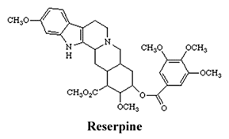
Reserpinum

Slide 63
(Reserpine)
PHARMACY - reser. Reserpinum. Reserpine. Alkaloid of Rauwolfia serpentina. Historical dose: All potencies.
CLINICAL - Allergies. Cancer. Catalepsy. Diarrhea. Duodenal, ulcer. Dyspepsia. Headache. Hemorrhoids. Hypotension. Hypothermia. Jaundice. Migraines. Melancholy. Nasal polyps. Parkinson's disease. Pharyngitis. Rhinitis.

Slide 64
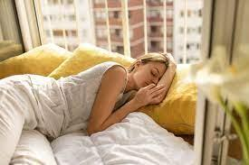
Its one of the new remedies that could be thought in Hypertension and such kind of health issues
HOMEOPATHIC - It is one of the alkaloids of Rauwolfia serpentina and was found commercially under the name of serpasil ciba. The proving was carried out by Julian on a group of thirteen provers during the winter of 1964-65, using the 3x, 5c, 7c, 9c, 15c and 30c potencies.
SLEEPINESS , DULLNESS , WEAKNESS , TREMBLING
Nervous depression
Suicidal states
( more intense than Rauwolfia )

Slide 65
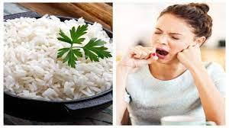
Sleepiness. Sleeping after meals. Slowing down of the mind and body. Asthenia, particularly accentuated between 3 p.m. and 4 p.m. General condition of weakness. Habitual trembling. General excitability. Anxiety. Suicidal tendencies.
Muscular hypertonia and a total lack of movement. Hard trophic edema. Intermittent stomach pains. Hypotension. Bradycardia. Vertigo. Allergies. Cancer.
MIND - Slowing down of the mind and body. Lassitude and aversion to work in the evening. Catalepsy. Nervous depression. Melancholy. Anxiety and suicidal tendencies. Difficulty working. Very hyperactive and aggressive. Feeling that the nerves are at skin level in the evening. Premature senility.
ABDOMEN - Spasmodic attacks of pain in the colon.
BREASTS - Excessive milk in the mother.

Slide 66
CONSTITUTIONS - Allergic and psoric constitutions. Syphilitic, asthenic types with tendency to inhibition of nervous reactions.
EYES - Myosis.
HEAD - Headache on waking, better by breakfast and worse again at the end of the morning.
HEART - Hypotension. Tension instability. Bradycardia, with vertigo. Permanently slow pulse.
LIMBS - Fidgets in the legs.

Slide 67
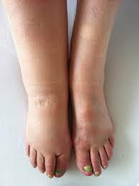
LUNGS - Laryngitis and tracheitis.
MOUTH - Tongue covered with a yellowish coating. Excessive salivation.
NOSE - Nasal obstruction. Congestive rhinitis. Nasal polyps.
RECTUM - Jaundice. Constipation followed by diarrhea. Diarrhea. Hemorrhoids.
SKIN - Dry, ligneous scabs. Hard, trophic edema. Lymphaedema. Dull and damp hair.

Slide 69
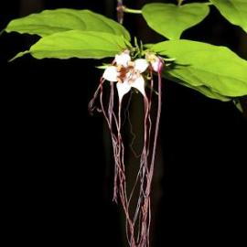
Strophanthus
Poison of Pahonias. N.O. Apocynaceae.

Slide 72
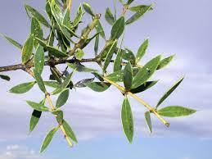
Quebercho
White Quebracho. N. O. Apocynaceae.

